Slide 1
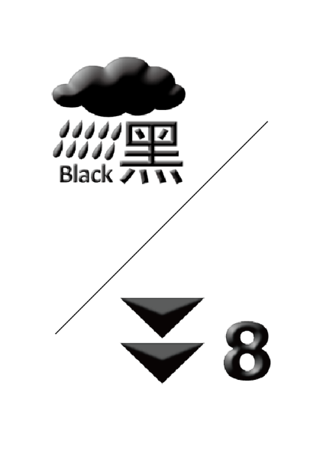

Arrangements under Typhoon and Rainstorm Signals
Opening hours: Tuesdays and Thursdays 10:00 am to 6:00 pm
Saturdays 10:00 am to 2:00 pm
Public Holidays and Other Days of the Week Closed
Warning/ Signal | Black Rainstorm Warning | Typhoon Signal No. 8 or Above
Issued before opening and valid during opening hours | Service suspended | Service suspended
Issued during opening hours | Provide normal service to whom have already arrived the clinic | Service suspended
Issued before opening, cancelled at least two hours before closing | Service resume within three hours after the warning is cancelled | Service resume within three hours after the signal is cancelled
Issued before opening, cancelled less than two hours before closing | Service suspended | Service suspended
Appointments during service suspension period will be cancelled automatically, please contact us at 2791-7222 after service resumed if you need to arrange a new appointment.
*When Typhoon Signal No.3 or below, Red Rainstorm Warning or Amber Rainstorm Warning is issued, service remains normal in our clinic.
Yan Chai Hospital Sai Kung Community Chinese Medicine Clinic

